Slide 1
Tree Annotation Summary
Andrea, Arlin, Enrico, Hillmar, Joachim, Ramona

Slide 2
Overall Workflow
Select a sample of trees (10 trees)
Develop a MIAPA-checklist annotation form
Exercise of annotating sample studies using MIAPA checklist
Develop a MIAPA ontology
Develop ontology-based annotations of sample trees
Import Trees and Annotations in TreeStore and run queries

Slide 3
Sample Datasets
Supertree of mammals from Bininda-Emonds, et al 2007
Angiosperm phylogeny group (APG) tree of APGIII
Peters, et al hymenoptera tree
Tree of Life Web Project Structure
Angiosperm phylogeny from Smith et al. 2011
Tree of 720 taxa from The Genomic Encyclopedia of Bacteria and Archaea (GEBA)
Avian phylogeny of Jetz, et al. 2012
All-species living (microbial) tree of life based on SSU rRNA
Tree of all Eukaryotes in Genbank from Goloboff et al. 2009
NCBI taxonomy tree

Slide 4
Sample Datasets
For each sample
  Actual data (Newick, NEXUS)
  Publication
  Supplemental Publication Materials

Slide 5
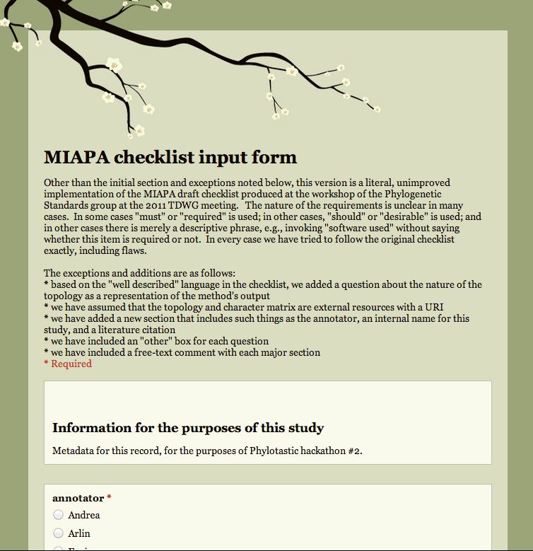
MIAPA Checklist Form and Application
Googledoc form
Generate Spreadsheet
  Pull-down menus
  Free-text boxes
Based on MIAPA draft checklist from the
TDWG 2011 workshop
Annotation of 10 sample studies
Identified
  Improvements of checklist
  Directions for MIAPA Ontology

Slide 6
MIAPA Ontology
OWL
Imports several ontologies
  CDAO
  BIBO
  PROV
  IAO
https://github.com/miapa/miapa/blob/master/ontology/miapa.owl

Slide 7
Ontology-based Annotations of Sample Studies
Bibliography
  BIBO
  Export from Zotero
  <bib:Article rdf:about="#item_3">
  <z:itemType>journalArticle</z:itemType>
  <dcterms:isPartOf>
  <bib:Journal>
  <dc:title>Nature</dc:title>
  <prism:volume>446</prism:volume>
  <prism:number>7135</prism:number>
  </bib:Journal>
  </dcterms:isPartOf>
  <bib:authors>
  <rdf:Seq>
  <rdf:li>
  <foaf:Person>
  <foaf:surname>Bininda-Emonds</foaf:surname>
  <foaf:givenname>O. R.</foaf:givenname>
  </foaf:Person>
  </rdf:li>
  <rdf:li>
  <foaf:Person>
  <foaf:surname>Cardillo</foaf:surname>
  <foaf:givenname>M.</foaf:givenname>
  </foaf:Person>
  </rdf:li>

Slide 8
Ontology-based Annotations of Sample Studies
Protégé-based Annotation of methods used
Derived from preliminary annotation using checklist

Slide 9
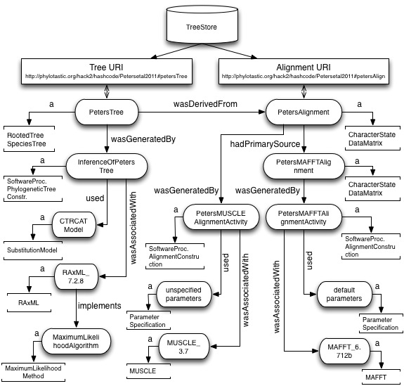

Slide 10
Ontology-based Annotation of Sample Studies
Identified
  Need for an interface for the generation of semantic descriptions (GSOC?)
  Need for modifications of MIAPA ontology
  Need for modifications of CDAO ontology

Slide 11
Interaction with TreeStore and Queries
Joachim

